Slide 1
Holo-RAG: Deep Dive Technical Breakdown

Slide 2

Introduction: Understanding the Phase Problem
What is Holography?
Holography captures both intensity and phase information of light, unlike conventional imaging that only records intensity.
The Phase Problem
Without phase data, we lose depth and structure—producing fuzzy, incomplete images at microscopic scales.
Why AI Matters
By learning the hidden relationship between intensity and phase, AI can recover the full holographic reality from incomplete signals.

Slide 3
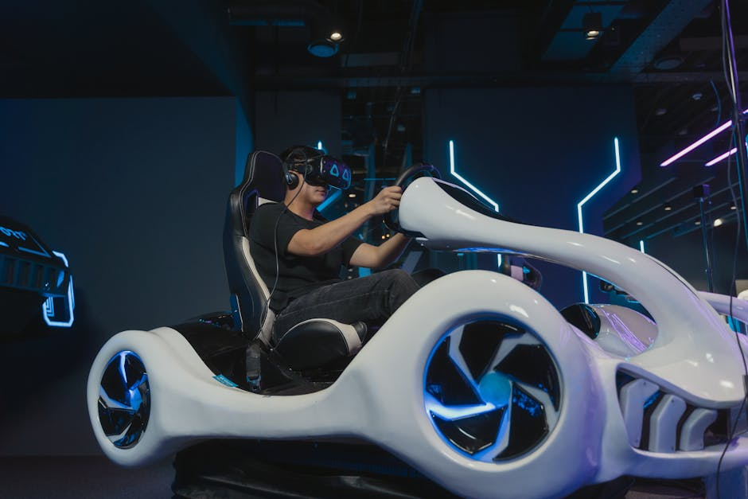
Theory and Data Simulation
Simulating Diffraction
Using TensorFlow’s fft2d, Holo-RAG models diffraction patterns—the physics of light interference on the sensor.
Adding Realism with Noise
By injecting sensor_noise, the data better mimics actual lab conditions, improving the model’s generalization.
From Synthetic to Real
This synthetic data pipeline allows pretraining on physically accurate holograms before fine-tuning on real experimental data.

Slide 4
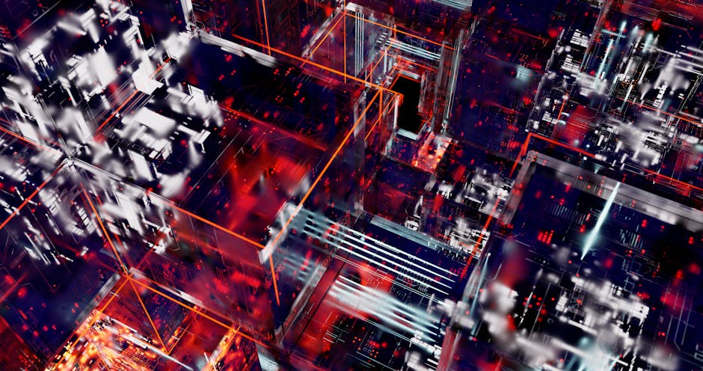
The Architecture: U-Net for Holographic Reconstruction
Why U-Net?
U-Net’s encoder-decoder structure with skip connections preserves spatial detail while enabling deep learning of physical relationships.
Skip Connections
Layers.concatenate passes high-frequency details directly across the network, avoiding blurry results common in deconvolution tasks.
Model Output
The U-Net outputs both amplitude and phase maps, reconstructing the object in physical space from holographic input.

Slide 5

The Secret Sauce: Custom SSIM-L1 Loss
Beyond MSE
Standard Mean Squared Error focuses on pixel intensity, often ignoring perceptual structure important for holography.
SSIM-L1 Hybrid Loss
The custom loss combines Structural Similarity (SSIM) with L1 loss, prioritizing accurate shape and contrast preservation.
Result
The hybrid loss produces reconstructions that are visually sharper and structurally faithful compared to pure MSE.

Slide 6

Live Demo Analysis: Validating Reconstruction
Inference Results
Running the final inference cell produces three rows of images—input, prediction, and ground truth.
Qualitative Evaluation
Focus on fine details such as the curvature of small objects or texture fidelity to assess SSIM’s impact.
Quantitative Metrics
SSIM and PSNR confirm improved reconstruction fidelity, validating the hybrid loss and model design.

Slide 7
What Does Holo-RAG Prove?
Conclusion: Scientific AI in Practice
Holo-RAG demonstrates that AI models can tackle physics-grounded problems, reconstructing reality from incomplete data. This marks a step toward scientific computation powered by machine learning.
Bridging Physics and Deep Learning

